Slide 1
Cardiovascular Physical Examination
Eman Kedir M.D., Internist, Assistant Professor of Internal Medicine

Slide 2
History and Examination of heart and blood vessels
Other parts of body where symptoms and signs of heart disease may appear
History - Chest pain and heaviness
- Dyspnea ,Exertional dyspnea, Orthopnea,Paroxysmal nocturnal dyspnea
- Ankle swelling
- Palpitation
- Syncope
- Fatigue

Slide 3
Past History
History of Ischemic heart disease: Myocardial Infarction
Rheumatic Fever
Sexual transmitted disease
Recent dental work, thyroid disease
Prior medical examination revealing heart disease
Drugs

Slide 4
Social History
Tobacco smoking and alcohol use of other substances
Occupation

Slide 5
Family History
Myocardial Infarcts
Cardiomyopathy
Congenital heart disease
Mitral valve prolapse

Slide 6
Functional status in established heart disease
Class 1 - disease present but no symptoms , or angina or dyspnea during unusually intense activity
Class 2 - angina or dyspnea during ordinary activity
Class 3 - angina or dyspnea during less than ordinary activity
Class 4 – angina or dyspnea at rest

Slide 7
Chest Pain
To help determine the cause of chest pain: - Duration
- Location
- Quality
- Precipitating and aggravating factors
- Means of relief and accompanying symptoms
- Radiation

Slide 8
Dyspnea
Shortness of breath
Unexpected awareness of breathing
Causes: - cardiac
- Lung disease
- Other causes like Anxiety

Slide 9
Orthopnea
Dyspnea that develops when the patient is supine
Causes of orthopnea
- Cardiac failure
- Uncommon causes
- Massive ascites
- Pregnancy
- Bilateral diaphragmatic paralysis
- Large pleural effusion
- Severe pneumonia

Slide 10
Paroxysmal nocturnal dyspnea
Severe dyspnea that wakes the patient from sleep so that the patient is forced to get up gasping breath
Ankle swelling – ankle edema of cardiac origin is usually symmetrical and worst in evenings
As failure progresses edema ascends to involve legs, thighs, genitalia and abdomen
Other common causes of edema- renal diseases( nephrotic syndrome)
- liver disese
- drugs

Slide 11
Palpitations
An unexpected awareness of the heart beat
Ask: slow or fast, regular or irregular and how long they last
sudden or gradual onset and offset
associated features: pain, dyspnea, faintness

Slide 12
Syncope,presyncope and dizziness
Syncope: A transient loss of consciousness
Presyncope: A transient sensation of weakness with out loss of consciousness
Establish whether patient actually loses consciousness & under what circumstances the syncope occurs:
- Postural syncope: on standing for prolonged periods or standing up suddenly
- Micturition syncope: while passing urine
- Tussive syncope: on coughing or
- Vasovagal syncope: with sudden emotional stress

Slide 13
Find out whether there is warning such as dizziness or palpitations, and how long the episodes last
Recovery may be spontaneous or the patient may require attention from bystanders
- abnormal movements ( epilepsy, primary syncope)

Slide 14
Fatigue
A common symptom of cardiac failure
May be associated with a reduced cardiac output and poor blood supply to the skeletal muscles
Other causes: lack of sleep, anemia,depression

Slide 15
Risk Factors
For coronary heart disease:
- Previous ischemic heart disease
- Hypercholesterolemia
- Smoking
- Hypertension
- A family history of heart disease
- A history of diabetes mellitus
- Renal failure

Slide 16
Valvular heart disease
History of dental decay or infection( risk of infective endocarditis)
Antibiotic prophylaxis before dental ( and some surgical procedures)

Slide 17
Treatment
Medication taking : often a good clue to diagnosis
Any ill-effects from current or previous medications
Surgical History
- Previous angioplasty or coronary artery bypass grafting
- If the patient is unable to provide a history; a middle sternotomy scar and scars consistent with previous saphenous vein harvesting

Slide 18
Past History
Previous angina or myocardial infarction
- How was diagnosis of ischemic heart disease made and in particular what investigations were undertaken

Slide 19
Social History
Whether patient’s condition has prevented from working and over what period
- Patient with severe cardiac failure,for example may need to take adjustments to their living arrangements
- So that they are not required to walk up and downstairs at home

Slide 20
Comprehensive History
First, appropriately expose and position patient properly and get impression of general appearance
Then begin with hands and pulses and progresses smoothly to neck, face and then to precordium

Slide 21
Positioning Patient
Lye patient in bed with enough pillows to support him or her at 45 degrees
- This is usual position in which jugular venous pressure is assessed
During auscultation, optimal examination requires further positioning of the patient

Slide 22
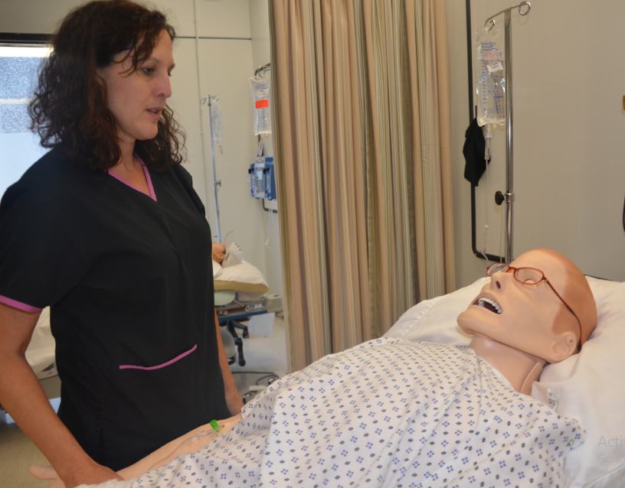
General Appearance- Look at general state of patient
- Does patient appear to be ill?
- Does patient at rest have rapid and labored respiration, suggesting dyspnea?
- Does patient look cachectic?
- Severe weight loss and muscle wasting( cardiac cachexia)

Slide 23
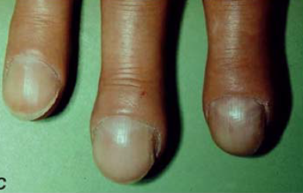
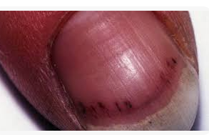
The hands- Look first at nails
- Look for clubbing
- Inspect fingernails (toenails) from side to determine if there is loss of angle between nail bed and finger
- Hyponychial angle
Nails- look for splinter hemorrhages in the nailbeds
- linear hemorrhages lying parallel to long axis of the nail
Clubbing

Slide 24
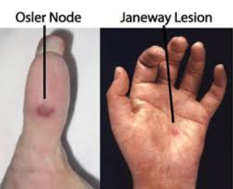
Osler’s node- red, raised tender nodules on the pulps of the fingers(or toes), or on the thenar or hypothenar eminences
Janeway lesions-non-tender erythematous maculopapular lesions containing bacteria, which occur very rarely on palms or pulps of fingers

Slide 25
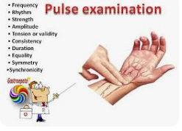
Arterial pulse- palpate radial artery at the wrist,just medial to the radius,using forefinger and middle finger pulps of examining hand
Observations to be made:
1. Rate of pulse, rhythm
2. Radiofemoral delay
- delay of femoral pulse compared with radial pulse
3. Character and volume of pulse
- better assessed from palpation of brachial or carotid arteries
4.Condition of the vessel wall

Slide 26
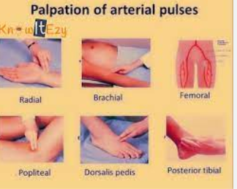
Arterial Pulse
Rate: count for 30 seconds or 1 minute to obtain rate per minute
- normal resting heart rate in adults: 60-100 beats per minute
Rhythm: regular or irregular
Radiofemoral delay- while palpating radial pulse, place fingers of other hand over femoral pulse( below inguinal ligament, one-third of the way up from the pubic tubercle

Slide 27
Arterial Pulse-Examine peripheral pulses: radial,brachial, carotid, femoral ,popliteal,posterior tibialis,dorsalis pedis
Arterial BP- essential
- indirect measurements of systolic and diastolic pressures are obtained with sphygnomanometer
- systolic BP- peak pressure that occurs in artery following ventricular systole
- diastolic BP- a level to which arterial BP falls during ventricular diastole
Normal- A systolic reading of < 140 mg mmhg and a diastolic reading of < 90 mmhg

Slide 28
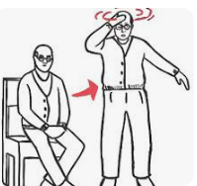
Postural Blood pressure
BP should routinely be taken with the patient both lying down and standing
A fall more than 15 mmhg in systolic BP or 10 mmhg in diastolic BP on standing is abnormal (= postural hypotension); it may cause dizziness or not be associated with symptoms

Slide 29
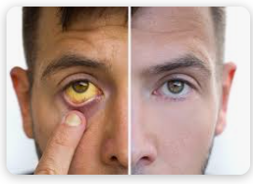
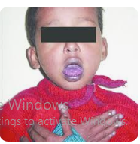
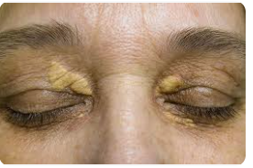

The face- inspect sclarae for jaundice, xanthelasmata (intra cutaneous yellow cholesterol deposits around the eyes)
Mitral facies: rosy cheeks with a bluish tinge
Mouth: a high arched palate(congenital heart disease), teeth, tongue and lips for central cyanosis, Inspect the mucosa for petechiae

Slide 30
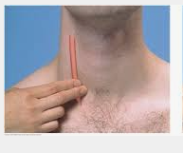
The neck:
- carotids: provide a great deal of information about the wave form of the aortic pulse, which is affected by many cardiac abnormalities
easily accessible, medial to the sternocleidomastoid muscles

Slide 31
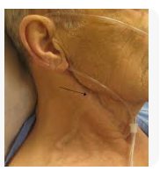
Jugular venous pressure- jvp- just as carotid pulse tells us about aorta and LV function, jvp tells us about right atrial and RV function
Positioning of the patient and lightening are important
Patient may be lying down at 45 degrees to the horizontal with his or her head on pillows and in good lighting conditions

Slide 32
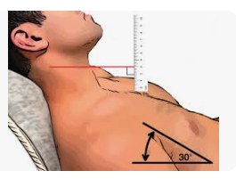
JVP- by convention,sternal angle is taken as the zero point
Maximum height of pulsations in internal jugular which are visible above sternal angle when patient is at 45 degrees is measured in centimetres
In the average person the centre of the right atrium lies 5 cm below this zero point
- Normal jvp< 3 cm

Slide 33
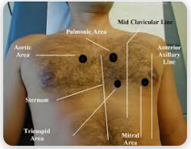
Precordium- Inspection
- Inspect first for scars- previous cardiac operations will have left scars on the chest wall
Skeletal abnormalities-pectus excavatum(funnel chest) or
-kyphoscoliosis(a curvature of vertebral column)
Look for the apex beats
- Normal position is in fifth left intercostal space, 1 cm medial to the midclavicular line
Look for other pulsations

Slide 34
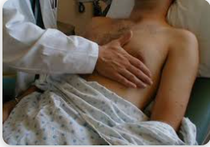
Palpation- Heart sounds
- palpation with fingers over pulmonary area may reveal palpable tap of pulmonary valve closure(palpable P2)
Thrill- palpable murmurs
Heave- parasternal impulse felt when heel of hand is rested just to left of sternum with fingers lifted slightly off the chest

Slide 35
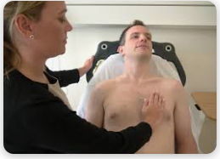
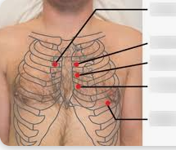
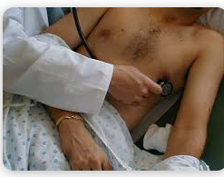
Auscultation- stethescope is needed
Begins in mitral area with bell of stethoscope
Next, listen in mitral area with diaphragm of the stethoscope
Then place the stethescope in tricuspid area( 5th left intercostal space) and listen
Next,left sternal edge to pulmonary( second left intercostal space) and aortic( second right intercostal space),listening carefully with diaphragm
Heart sounds(S1 and S2)
Added sounds( murmurs,gallop,friction rub)
Palpable murmur Heart sounds Auscultation

Slide 36
Other parts of the body
Back- percussion and auscultation of the lung bases
Abdomen-liver, spleen,ascites,hepatojugular reflux,pulsations
Lower limbs- edema,cyanosis,clubbing

